Slide 1


Green Pace
Security Policy Presentation
Developer: Chandler Duhamel
CS-405
June 20th, 2025
https://youtu.be/ZLVYrSyPGao

Slide 2
OVERVIEW: DEFENSE IN DEPTH
Green Pace has designed a security policy to standardize the development practices across the entire company. With the company growing at a rapid pace, it is critical that Green Pace provides a development standard that is not only secure but also follows best practices. This will ensure security is at the forefront of concerns during the development process.

Slide 3
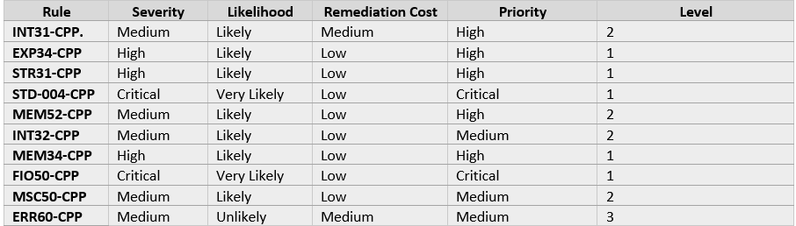
THREATS MATRIX
Prioritized issues based on likelihood of occurrence and impact on the system. To identify these risks we use tools like SonarQube and Clang-Tidy

Slide 4
10 PRINCIPLES
Validate Input data: EXP34-CPP, FIO50-CPP
Heed Compiler Warnings: INT31-CPP, INT32-CPP
Architect for Security: STD-004-CPP
Keep It Simple: MSC50-CPP
Default Deny: TRIPLE-A Policies
Least Privilege: MEM52-CPP
Sanitize Shared Data: STD-004-CPP
Defense in Depth: ALL
QA Techniques: Unit testing and use of static tools (I.E SonarQube and Clang-Tidy)
Secure Coding Standards: Following these standards.

Slide 5
CODING STANDARDS
STD-004-CPP – SQL Injection
FIO50-CPP – File Path Injection
STR31-CPP – Unsafe String Copy
MEM34-CPP – Improper Memory Deallocation
EXP34-CPP – Input Validation
INT32-CPP – Overflow
MEM52-CPP – Memory Leak
INT31-CPP – Type Conversion
MSC50-CPP – Insecure Random
ERR60-CPP – Exception Safety

Slide 6
ENCRYPTION POLICIES
In Flight: TLS 1.2+ is mandatory for all network communications.
In Use: Sensitive data is protected while in memory through memory sanitation and strict controls.
At Rest: AES-256 encryption is used to protect all stored sensitive data.

Slide 7
TRIPLE-A POLICIES
Authentication: All users are required to sign in with unique credentials in order to log into the system.
Authorization: Information should be available to users using the principle of least privilege.
Accounting: User activity is logged and checked regularly.

Slide 8
Unit Testing
Is the collection empty upon creation?
Logic: Check is collection is empty after creation. This is done by using empty() or size()
Expected Result: Returns size – 0
Pros: Prevents unexpected behavior or stale data exposure.

Slide 9
Unit Testing
Does the collection throw when accesses is out of bounds?
Logic: Access index that is higher that the amount of elements present.
Expected Results: Throws std::out_of_range exception.
Pros: Prevents memory access violations and crashes

Slide 10
Unit Testing
Does resizing the vector behave as expected?
Logic: Resize vector up, down, and to 0
Expected Results: ize changes to match resize().
Pros: Confirms proper memory handling and size control

Slide 11
Unit Testing
Does reserve increase capacity but not size?
Logic: Reserve more capacity, confirm size remains 0
Expected Results: Capacity will increase or stays at 0
Pros: Verifies boundary control, avoids bugs

Slide 12

AUTOMATION SUMMARY

Slide 13
TOOLS
Green Pace employs a DevSecOps pipeline to ensure security is integrated throughout the development lifecycle. This means we use tools and tests to find problems early and not just at the end of the process, when it would be too late. Developers use built-in tools like SonarQube, Clang-Tidy and Cppcheck while coding to discover issues like memory leaks or improper handling of inputs. Other tools like Coverity will scan code in depth for hidden vulnerabilities once the code is ready to be built. We also employ GoogleTest to run unit tests automatically to verify that all of the code works correctly. After code is deployed, we track things like firewall activity and system logs for anything unusual. By taking advantage of this type of automation, we can find and solve problems quickly, keep everyone on the same page, and help support our layered security.

Slide 14
RISKS AND BENEFITS
One of the largest risks we are taking is to retain existence of legacy code and legacy functions that do not meet and follow security standards. For instance, legacy functions and arms of legacy code can exist in things such as the use of strcpy() or unvalidated SQL inputs. If we act now and remove these legacy functions and code, and replace them with up-to-date functions such as strncpy() or use prepared statements, we have change the probability of a successful buffer overflow or SQL injection attack. The longer we wait, the more chances of a breach, risk of lost data, lost lawsuits, or compliance failures. While yes, we don't want too re-write everything all at once, it takes time and resources. We can, however, prioritize vulnerabilities and find attacking the greatest risk vulnerabilities first, and this gives some quick wins to the team without overwhelming them. The upside to acting now is creating confidence in our product and reducing the amount of future technical debt.

Slide 15
RECOMMENDATIONS
Our existing policy addresses the majority of significant coding threats, however does not support real-time threat detection capability or education for developers regarding security which are becoming increasingly important as threats are evolving. Adding threat modeling tools with education for developers to successfully code to remain secure would bridge most of those gaps. We should also extend our policies to address security for mobile apps and cloud services because both are still growing. For example ThreatMapper or SecureFlag will provide organizations tools to help the team identify and respond to threats, before going to production.

Slide 16
CONCLUSIONS
In order to remain ahead of future threats, Green Pace could implement additional secure coding standards such as the OWASP Top Ten and continue monitoring the SEI CERT C++ rules. We should also review the policies and ensure that automation continues to be updated. Making security a joint responsibility amongst the team with clear standards and reviews will allow us to better protect our software and our users in the future.

Slide 17
REFERENCES
SonarSource. (2025). SonarQube Documentation. https://www.sonarsource.com/products/sonarqube/
SEI CERT C++. (2024). Secure Coding Standards. Carnegie Mellon University. https://wiki.sei.cmu.edu/
OWASP Foundation. (2024). OWASP Top Ten. https://owasp.org/www-project-top-ten/
Microsoft. (2024). C++ Unit Testing with GoogleTest. https://learn.microsoft.com/en-us/visualstudio/test/unit-test-your-code
ThreatMapper by Deepfence. (2024). https://www.deepfence.io/threatmapper/SecureFlag. (2024). Secure Coding Training Platform. https://www.secureflag.com/

